Slide 1
RESEARCH DISSERTATION
Characterization of viscoelastic flows in a four-roll mill with physics-informed neural networks
Daniele Infante
Maurizio De Micco
Massimiliano Maria Villone
September 2026

Slide 2

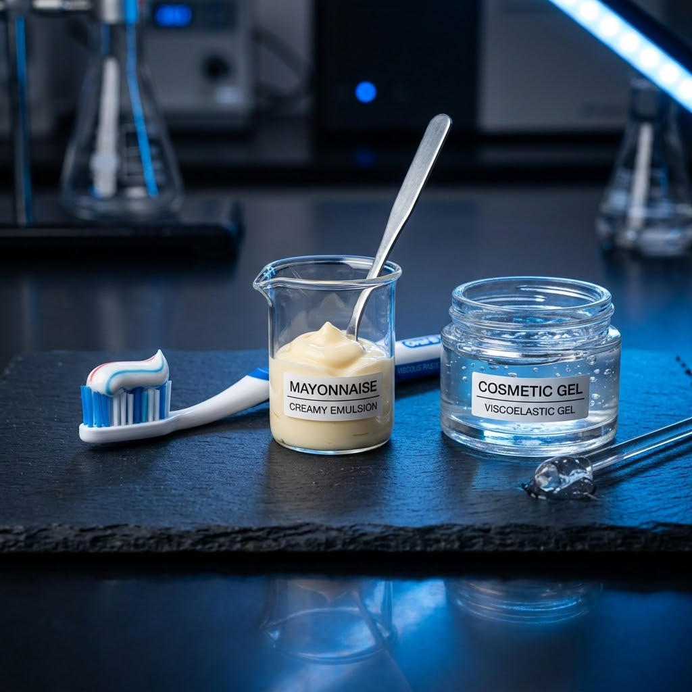
INTRODUCTION
The Viscoelasticity Problem: Relevance and Mathematical Complexity
01 / FLUID PHYSICS
Elasticity & Fading Memory
Viscous dissipation, elasticity & deformation history
02 / APPLICATIONS
Technological & Bio Systems
Polymer extrusion, spinning, blood & microfluidics
03 / MODELING
Governing Equations
Non-linear constitutive models (Oldroyd-B, PTT) & mixed nature
Notes:
maionese e qualche altra cosa

Slide 3
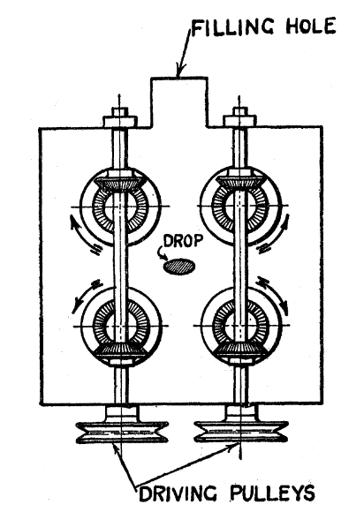
INTRODUCTION
The 4-Roll Mill: Principles & Characteristics
01 / KINEMATICS
Independent Roll Rotation
Independent roll speed and direction control to generate varied flow regimes
02 / CENTRAL REGION
Stagnation Point
Extensional stagnation point created at the center for fluid characterization.
Reference: Taylor et al. (1934) - The formation of emulsions in definable fields of flow
Reference: Fuller et al. (1980) — Flow birefringence of dilute polymer solutions in two-dimensional flows

Slide 4
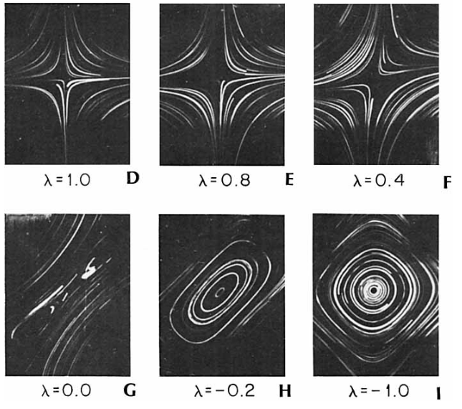
INTRODUCTION
4-Roll Mill Flow Fields
α ≡ λ
01 / FLOW REGIME
Extensional Flow (α=1)
Generated when opposing rolls rotate symmetrically, creating pure stretching motion along the central stagnation point.
02 / CONTINUOUS SPECTRUM
Intermediate & Shear Flows (α=0)
By continuously tuning roll speed ratios, a full spectrum (-1 < α < 1) of intermediate regimes is generated, passing through shear flow.
03 / FLOW REGIME
Rotational Flow (α=-1)
Achieved by driving rolls to induce co-rotational vorticity, placing fluid elements in pure rigid-body rotation.
Reference: Fuller et al. (1981) — Flow birefringence of concentrated polymer solutions in two-dimensional flows

Slide 5
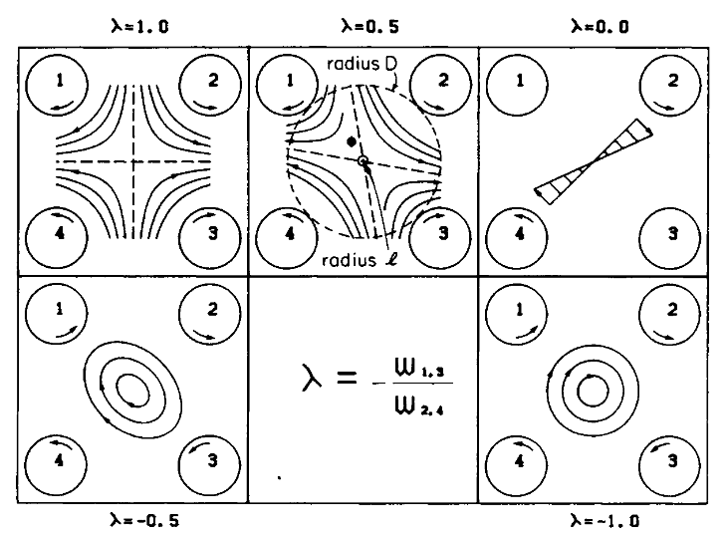

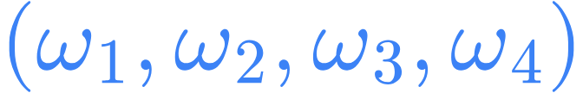



INTRODUCTION
4-Roll Mill Flow Fields
01 / KINEMATIC RELATION
(strain rate/scale of deformation), (flow regime parameter)
ω1 = ω3 = Ω, ω2 = ω4 = −αΩ (−1 ≤ α ≤ 1)
α
α
 | Velocity | Flow Regime
1 |  | Planar extensional
0 |  | Simple shear
-1 |  | Pure rotational
Reference: Fuller et al. (1981) — Flow birefringence of concentrated polymer solutions in two-dimensional flows
Notes:
Condensare con slide precedente

Slide 6

From Traditional CFD to Inference: Limits in Inverse Problems
01
THE INVERSE PROBLEM
Parameter Estimation
Aims to estimate unknown constitutive parameters (relaxation time λ, solvent/polymer viscosity ηₛ, ηₚ).
Inferred directly from experimental field measurements (e.g., PIV velocity fields).
02
FEM / CFD BOTTLENECKS
Classical Limitations
Iterative Process: Depends on complex trial-and-error or adjoint sensitivity analysis.
Prohibitive Cost: Requires full nonlinear meshed solves at every optimization step.
Numerical Instability: Divergence at high Weissenberg numbers (Wi) breaks optimizers.
03
NEW PARADIGM
Physics-Informed NNs
Replaces pure mesh-based solvers with continuous neural representations (PINNs).
Natively incorporates experimental data and differential physical constraints into the loss function for seamless parameter inference.
Notes:
da inserire nel literature gap

Slide 7
From Traditional CFD to Inference: Limits in Inverse Problems
01
THE INVERSE PROBLEM
Parameter Estimation
Aims to estimate unknown constitutive parameters (relaxation time λ, solvent/polymer viscosity ηₛ, ηₚ).
Inferred directly from experimental field measurements (e.g., PIV velocity fields).
02
FEM / CFD BOTTLENECKS
Classical Limitations
Iterative Process: Depends on complex trial-and-error or adjoint sensitivity analysis.
Prohibitive Cost: Requires full nonlinear meshed solves at every optimization step.
Numerical Instability: Divergence at high Weissenberg numbers (Wi) breaks optimizers.
03
NEW PARADIGM
Physics-Informed NNs
Replaces pure mesh-based solvers with continuous neural representations (PINNs).
Natively incorporates experimental data and differential physical constraints into the loss function for seamless parameter inference.
Notes:
da inserire nel literature gap

Slide 8
Literature Gap
01
CURRENT STATE
Simple Benchmarks
Recent developments in PINNs for viscoelastic (VE) fluids have been demonstrated only on simple benchmark problems (such as ViscoelasticNet).
02
THE GAP
Complex Geometries
There is a need to bridge this gap by extending models to handle complex geometries with realistic, relevant flow features.
03
OBJECTIVE
Generalization
Developing robust neural network architectures capable of generalizing across diverse physical cases and complex fluid dynamics scenarios.

Slide 9

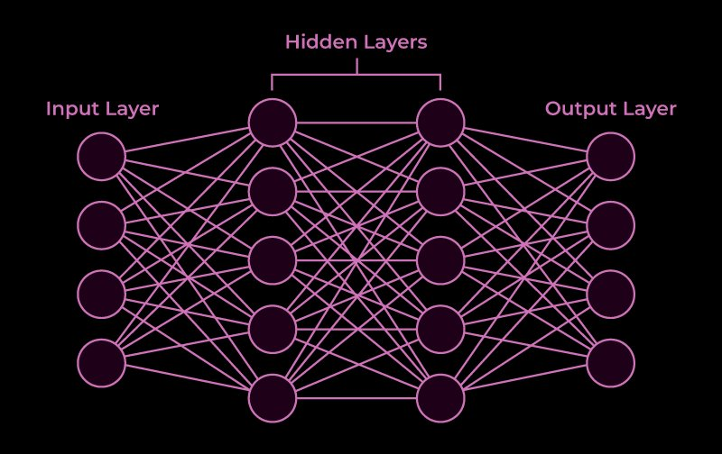
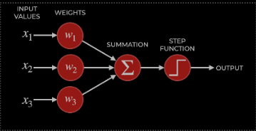
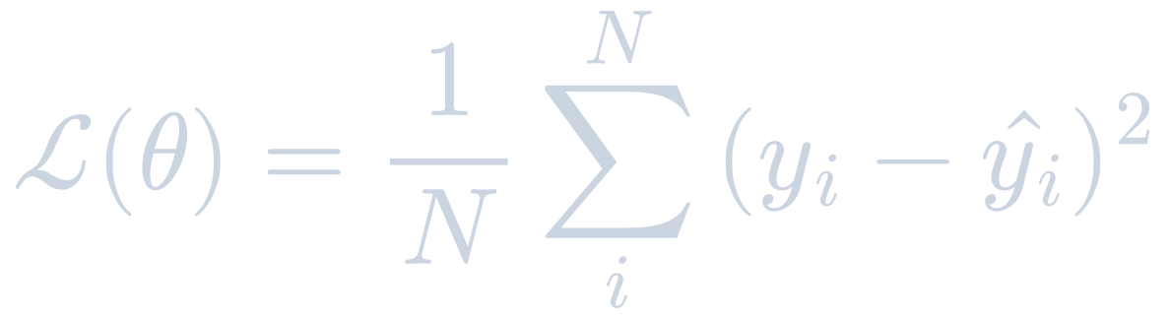
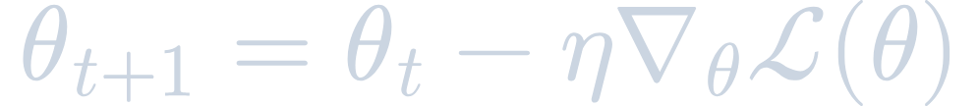
Fundamentals of Deep Learning
01 / ARCHITECTURE
Fully Connected
02 / PERCEPTRON
Activation Function
03 / OPTIMIZATION
Loss & Gradient Descent
Reference: Goodfellow, I., Bengio, Y., & Courville, A. (2016) — Deep Learning, MIT Press.
Notes:
Condensare tutto il concetto delle pinn: che cos ‘è loss e come si inserisce la fisica dentro

Slide 10
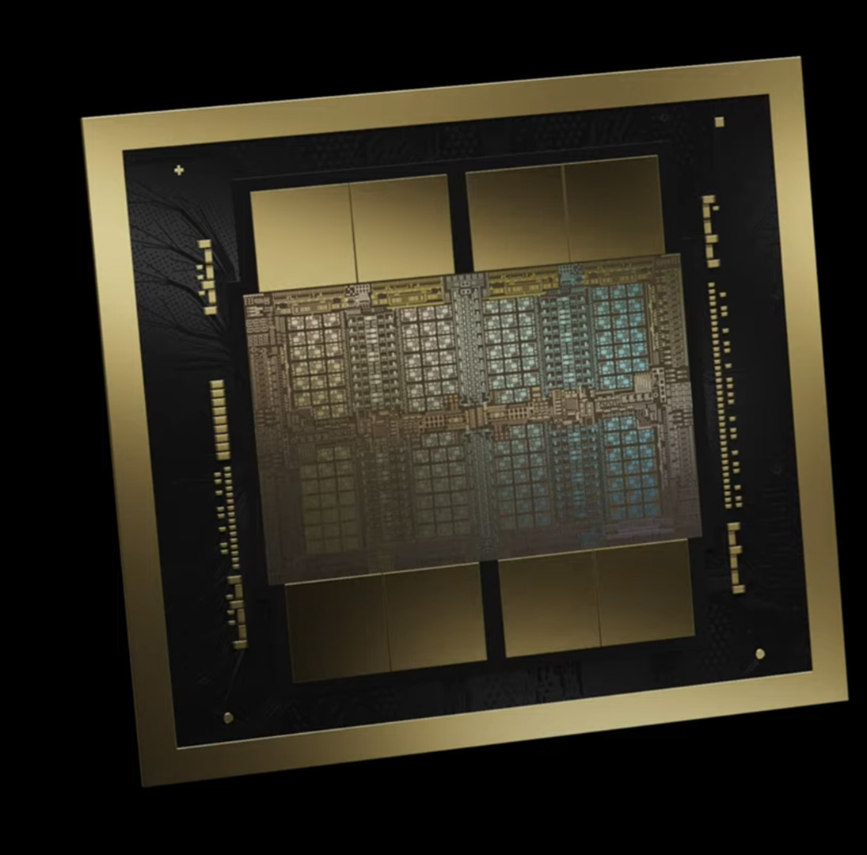
Why Neural Networks?
01 CAPABILITIES
Cross-Domain Success
Neural networks have demonstrated exceptional problem-solving capabilities across various scientific, engineering, and data-driven domains.
02 FUNCTION APPROXIMATION
High-Dimensional Modeling
Acts as universal approximators capable of handling non-linear differential equations and high-dimensional continuous systems without grid constraints.
03 HARDWARE SYNERGY
Computational Progress
Modern computational hardware (GPUs, TPUs) is heavily optimized for parallel tensor operations, aligning directly with deep learning architectures.
NVIDIA Blackwell B200 GPU Die
Notes:
out

Slide 11
Limits of Neural Networks
01
DATA DEPENDENCY
Limited Data Availability
Standard neural networks rely heavily on large volumes of labeled data, performing poorly or overfitting in data-scarce domains.
02
PHYSICAL CONSISTENCY
No Physical Grounding
Purely data-driven models lack embedded physical laws, often predicting solutions that violate fundamental physical constraints.
03
TRANSPARENCY
Interpretability
Complex architectures lack interpretability, making it difficult to analyze failure modes or trust outputs in critical applications.
Notes:
Appis black box, c’è il limite di estrapolare al di fuori del dominio dei punti usati per il training

Slide 12

Physics-Informed Neural Networks (PINNs)
Hybrid Paradigm
Bridges the structural gap between classical numerical PDE solvers and flexible modern deep learning architectures.
Loss Regularization
Embeds partial differential equations (PDEs) directly into the neural network's loss function to serve as an exact regularization mechanism.
Data Efficiency
Drastically reduces the volume of large labeled datasets required for training while enforcing continuous physical consistency.
Model Explainability
Provides physical interpretability and transparency by grounding neural representations in governing physical laws.
Reference: Raissi et al. (2019) — Physics-informed neural networks: A deep learning framework for solving forward and inverse problems involving nonlinear partial differential equations

Slide 13

PINN Framework – Physical Information
DATA-DRIVEN COMPONENT
Loss of Data Mismatch
Penalizes difference against sparse experimental observations.
Supervised Learning: Evaluates Mean Squared Error (MSE) at discrete measurement points.
Empirical Grounding: Ensures model predictions conform strictly to observed sensor data & initial/boundary conditions.
PHYSICS-INFORMED COMPONENT
Loss of Physics Residuals
Enforces governing PDE laws at unlabelled collocation points.
Exact Differentiation: Computed across domain collocation points via Automatic Differentiation (AD).
PDE Regularization: Penalizes violations of differential conservation laws (e.g. Navier-Stokes).
Inverse problem: Infer the physical parameters that best suit experimental data
Notes:
"Il punto di rottura rispetto al machine learning convenzionale è che non trattiamo la fisica come un dataset di training, ma come un vincolo strutturale all'interno della loss function. Grazie alla differenziazione automatica, la rete 'conosce' le derivate esatte della PDE. Questo permette di lavorare in contesti mesh-free e con pochissimi dati sperimentali."
mi serve qyualcosa su automatic differtentiatio

Slide 14



PINN Framework – Automatic Differentiation
THE ANALOGY
Backpropagation vs. Coordinate AD
Just as standard gradient descent uses automatic differentiation to compute parameter gradients, it’s possible to use computational graph to compute derivatives with respect to spatial inputs.
EXACT DIFFERENTIATION
Pointwise Differential Operators
Evaluates exact PDE residuals ( ) at continuous coordinates without truncation errors, avoiding any finite-difference stencil.
FUNDAMENTAL PROPERTY
Meshless Formulation
Completely decouples differential evaluation from geometric topology: collocation points require no cell connectivity, adjacency lists, or domain re-meshing.
PARAMETER SPACE OPTIMIZATION
Loss surface optimized via gradient descent, driving the physics-based PDE residual to zero across all collocation points.
Reference: Baydin et al. (2018) — Automatic differentiation in machine learning: a survey
Notes:
paper di backpropagatoin proprio di hinton come reference

Slide 15
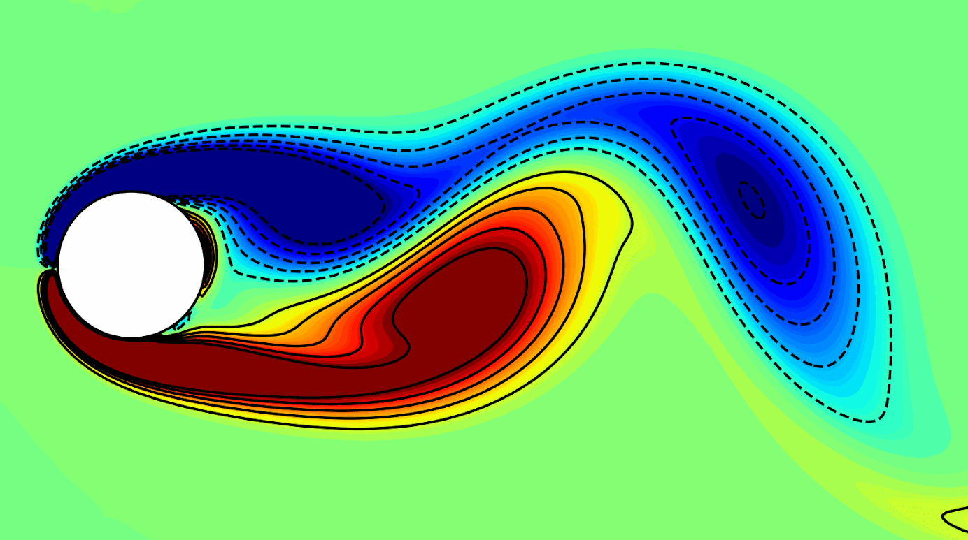
Navier-Stokes Case Study – Flow Past a Cylinder
Problem Setup, Physical Assumptions & Flow Regime
FLUID PROPERTIES
Physical Assumptions
Newtonian & Incompressible: Constant viscosity, ∇ · u = 0
Governing Model: 2D Navier-Stokes equations
FLOW VISUALIZATION
GEOMETRY & DOMAIN
2D Flow Setup
Obstacle: Circular rigid cylinder with downstream wake
Sparse Sampling: N = 5,000 points (1% space-time)
FLOW REGIME
Reynolds Number (Re = 100)
Vortex Shedding: Unsteady Kármán vortex street
Inverse Identification: Parameter recovery (λ₁, λ₂)
Reference: Raissi et al. (2019) — Physics-informed neural networks: A deep learning framework for solving forward and inverse problems involving nonlinear partial differential equations

Slide 16










Navier-Stokes Case Study – Physical vs. PINN Formulation
Inverse Parameter Identification & Physical Model
REAL PHYSICAL PROBLEM
Real Navier-Stokes Equations
Momentum Balance:
Continuity Equation:
PINN FORMULATION
Learned Parameterized Equations
The network learns latent fields and concurrently estimates unknown parameters and .
Residual Loss Formulation:
Exact Continuity Satisfaction ( ):
Inverse Parameters Sought by Model:
• (Convective Term): Models inertial advective transport.
• (Diffusive Viscosity): Corresponds to in the Newtonian case.
Notes:
tagliare proprio tutto da qua diciamo solo che esistono previous cases

Slide 17
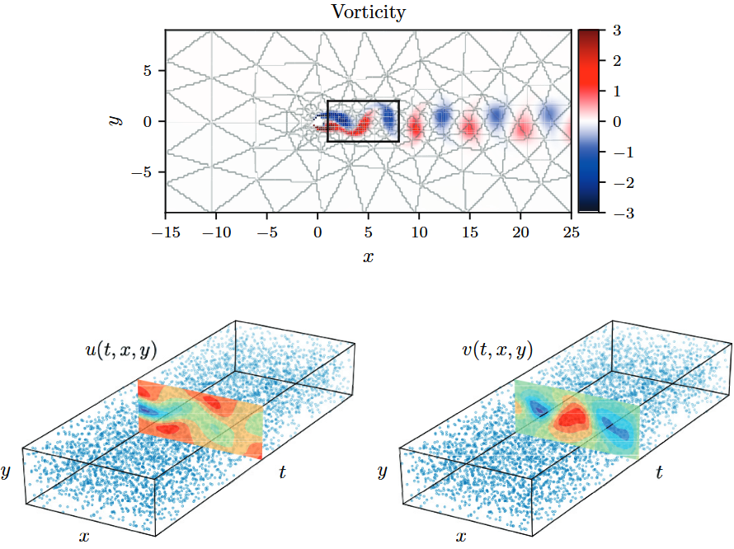
Navier-Stokes Case Study – Modeling and Training Parameters
HYPERPARAMETERS & SETUP
Model Architecture
• Activation
tanh
• Layers & Neurons
1 network with 9 FC layers × 20 neurons, 2 outputs
• Optimization
Adam(200k) + L-BFGS (50k)
• Learning Rate
η₀ = 10⁻³ fixed
• Sampling Points
N = 5,000 (1% of total data)
REPRESENTATIVE FLOW FIELDS
Velocity (u, v) data points

Slide 18
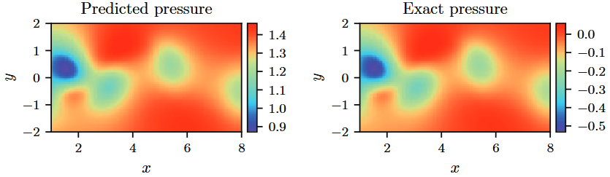
Navier-Stokes Results – Accuracy & Pressure Field
QUANTITATIVE VALIDATION
Robust Parameter Identification
Inverse estimation of physical coefficients λ₁ and λ₂:
Clean Data: λ₁ error 0.08%, λ₂ error 4.67%
1% Gaussian Noise: λ₁ error 0.17%, λ₂ error 5.70%
High stability under experimental measurement noise.
KEY BREAKTHROUGH
"Hidden" Pressure Field Reconstruction (p)
Zero Pressure Training Data: No pressure measurements were supplied during training.
Physics-Driven Inference: The complete scalar pressure field p(t, x, y) is inferred strictly via pressure gradient constraints in momentum equations.
Matches pressure reference up to an additive constant.
Notes:
funziona, devo mettere dei risultati decenti.
"Il takeaway più forte è che la rete è riuscita a ricostruire fedelmente l'intero campo di pressione senza aver mai visto una singola misura di pressione, ma solo velocità sparse. Questo evidenzia il potenziale reale delle PINN: non semplici solutori per sostituire OpenFOAM o codici commerciali, ma strumenti potenti di data-assimilation e stima di grandezze latenti da misure sperimentali rumorose."

Slide 19
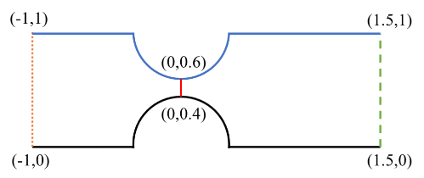
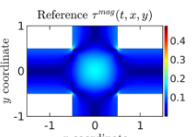
ViscoelasticNet
CORE DOMAIN
Viscoelastic Fluid Modeling
KEY CHARACTERISTICS
Non-Newtonian Flow
Non-Linear Stresses
High Weissenberg Instabilities
BENCHMARK CASE STUDIES
Stenosis & Cross-Slot Flows
INVERSE FORMULATION
Parameters & VE Model Selection
CAPABILITIES
Parameter Estimation: Learns relaxation time ( ) and viscosity parameters ( ) directly from data.
Constitutive Discovery: Classifies Oldroyd-B, Giesekus, or PTT model dynamics.
Data-Driven: Reconstructs stress fields from sparse velocity observations.
Reference: Thakur et al. (2024) - ViscoelasticNet: A physics informed neural network framework for stress discovery and model selection
Notes:
cose più leggibili

Slide 20



ViscoelasticNet: Constitutive model(s)
UNIFIED CONSTITUTIVE FORMULATION
MODEL SELECTION CRITERIA
ϵ = 0, α = 0
Oldroyd-B Model
Standard quasi-linear fluid model with constant viscosity and relaxation time.
ϵ = 0, α ≠ 0
Giesekus Model
Includes non-linear anisotropic drag effects via mobility parameter (α).
ϵ ≠ 0, α = 0
Linear PTT Model
Phan-Thien–Tanner model incorporating polymer extensibility parameter (ϵ).
ϵ ≠ 0, α ≠ 0
None of the Three
Model rejected for canonical subset (e.g., validated via XPomPom test cases).

Slide 21
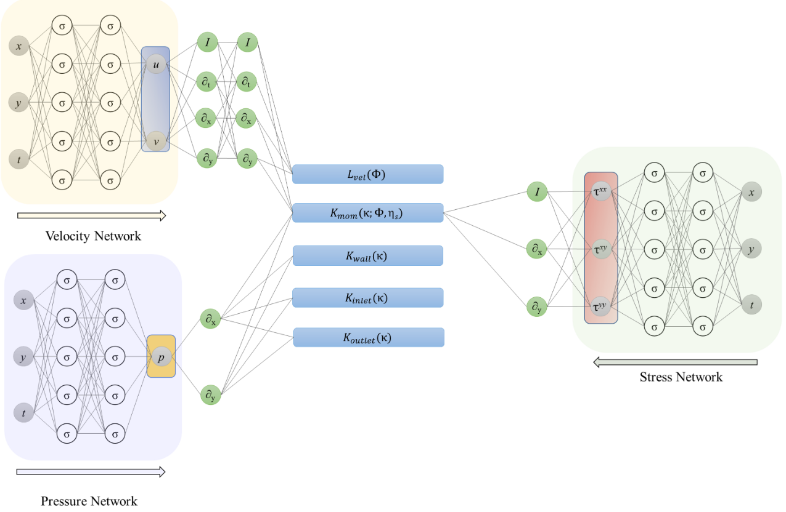
Multi-Network Architecture & Decoupled Optimization
ARCHITECTURE & PIPELINE
3 Dedicated Neural Networks
DECOUPLED OPTIMIZATION
Two-Stage Sequential Training
STAGE 1: Stress & Rheology
Joint optimization of velocity, stress tensor, and material rheological parameters (λ, ε, α, ηₚ) via ℒ_stress loss.
STAGE 2: Pressure & Viscosity
Freeze Stress Network weights; train Pressure Network and estimate solvent viscosity ηₒ by minimizing momentum residual.
Reference:Thakur et al. (2024) - ViscoelasticNet: A physics informed neural network framework for stress discovery and model selection
Notes:
Per evitare problemi di convergenza derivanti dall'accoppiamento rigido di Navier-Stokes viscoelastico, gli autori disaccoppiano il problema: prima risolvono l'equazione costitutiva per identificare sforzi e modello reologico; poi congelano lo stress network e risolvono il bilancio della quantità di moto per ricavare pressione e viscosità del solvente. Anche qui, la conservazione della massa è garantita alla radice tramite la stream function $\psi$

Slide 22
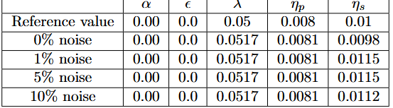
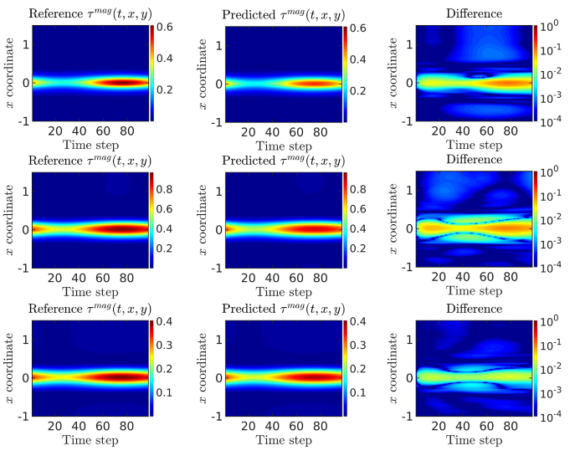
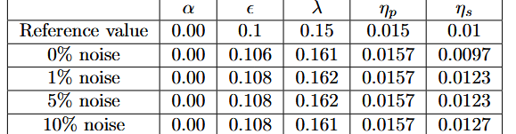
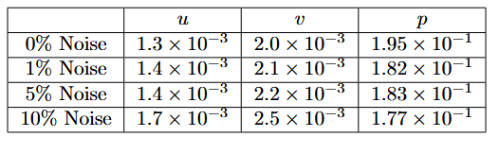

ViscoelasticNet: 2D Stenosis Results
STRESS FIELD COMPARISON
PARAMETER IDENTIFICATION UNDER NOISE
FIELD ACCURACY & RELATIVE ERROR FORMULATION

Slide 23
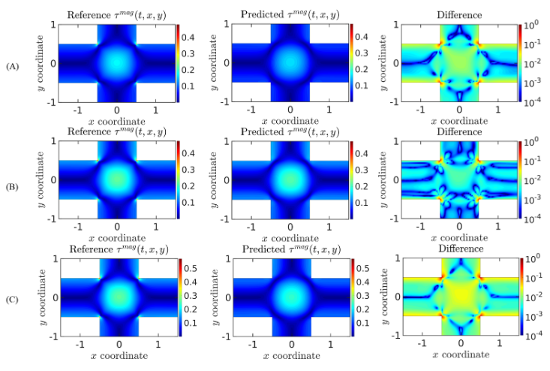
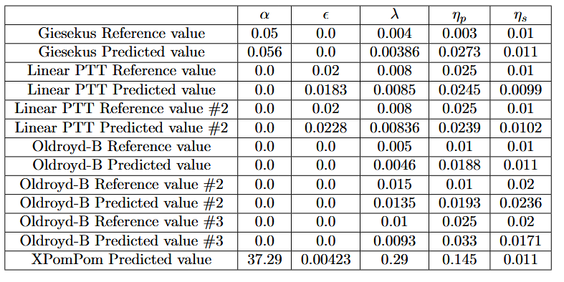
ViscoelasticNet: Cross-Slot Flow Results
STRESS FIELD COMPARISON
PARAMETER IDENTIFICATION & PREDICTED VALUES

Slide 24
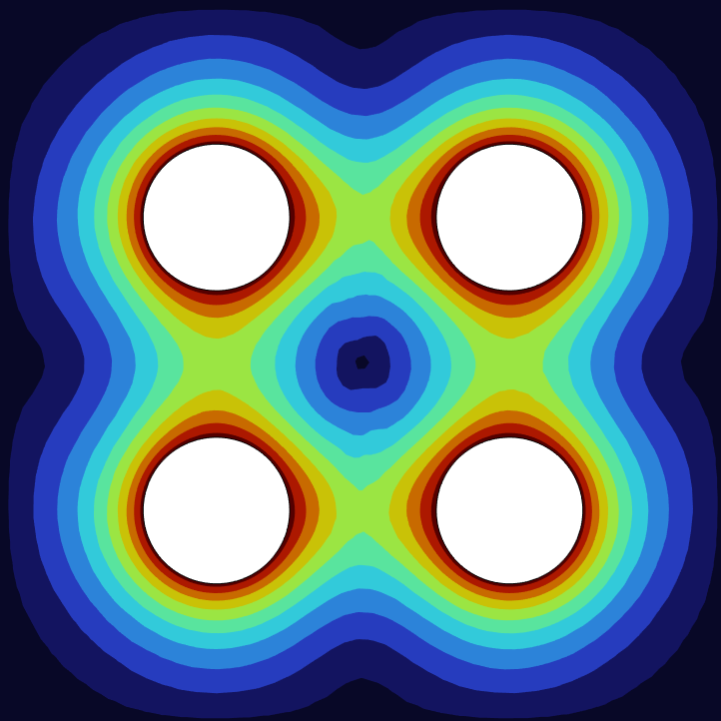
goodfellow deep learning
Overview of our work
01 PARAMETER EXTRACTION
Physical Parameters
PINN applied to a four-roll mill geometry to extract key physical parameters from experimental fluid dynamics data.
02 MODEL SELECTION
Constitutive Modeling
Identification and evaluation of the constitutive model that best fits and describes experimental observations.

Slide 25
Differences from ViscoelasticNET
01
REGIME TYPE
Steady-State
Formulated exclusively for stationary conditions ⟶ ∂/∂t = 0.
Neglects transient fluid dynamics to isolate steady flow behavior and optimize computational focus.
02
SCOPE & STAGE
Phase 1 Focus
Restricted to initial baseline configurations ⟶ Phase 1.
Constitutive Models:
Focuses exclusively on Oldroyd-B and Giesekus models.
03
OPERATIONAL BOUNDS
Extended Ranges
Significantly wider parameter space vs ViscoelasticNET benchmark:
λ: up to 1 s (vs 0.15 s, 10×)
ηₚ: up to 0.98 Pa·s (vs ≤0.025 Pa·s, 40×)
α: up to 0.50 (vs 0.20)

Slide 26
ViscoelasticNet: Results
VALIDATION GEOMETRIES
Benchmark Flow Cases
1. 2D Stenosis Flow
Hemodynamic pulsatile sinusoidal flow validation:
< 5% relative error on stress fields.
Accurate classification of Oldroyd-B, Linear PTT, and Giesekus models.
2. Cross-Slot Flow
Strong extensional flow benchmark:
Correct identification of non-linear rheological parameters.
Capturing stress singularities at sharp corners requires domain decomposition.
DATA ROBUSTNESS
Noise & Sparsity Tolerance
Gaussian Noise Resistance
Tested with up to 10% Gaussian noise on velocity fields.
Up to 25% noise on boundary conditions.
Learned rheological parameters remain robustly stable.
Sparse Data Threshold
Maintains high accuracy down to 5 × 10⁴ total points.
Fully compatible with resolutions from real experimental measurements.
PRACTICAL IMPACT
Experimental PIV Integration??
The PIV Limitation
Laboratory Particle Image Velocimetry (PIV) only provides kinematic velocity fields; internal stresses and pressure are inaccessible directly.
Full-Field Virtual Rheometer
ViscoelasticNet acts as a virtual rheometer:
Uncovers full stress tensors and pressure fields directly from raw PIV data.
Identifies underlying constitutive equations automatically.
Notes:
Il vero valore applicativo di ViscoelasticNet risiede nell'integrazione con tecniche come la micro-PIV. Sperimentalmente è facile misurare campi di velocità, ma quasi impossibile misurare direttamente il tensore degli sforzi polimerici o la pressione in geometrie complesse. Questo framework estrae la reologia direttamente dall'osservazione del moto, aprendo la strada alla caratterizzazione fluidodinamica in-situ

Slide 27
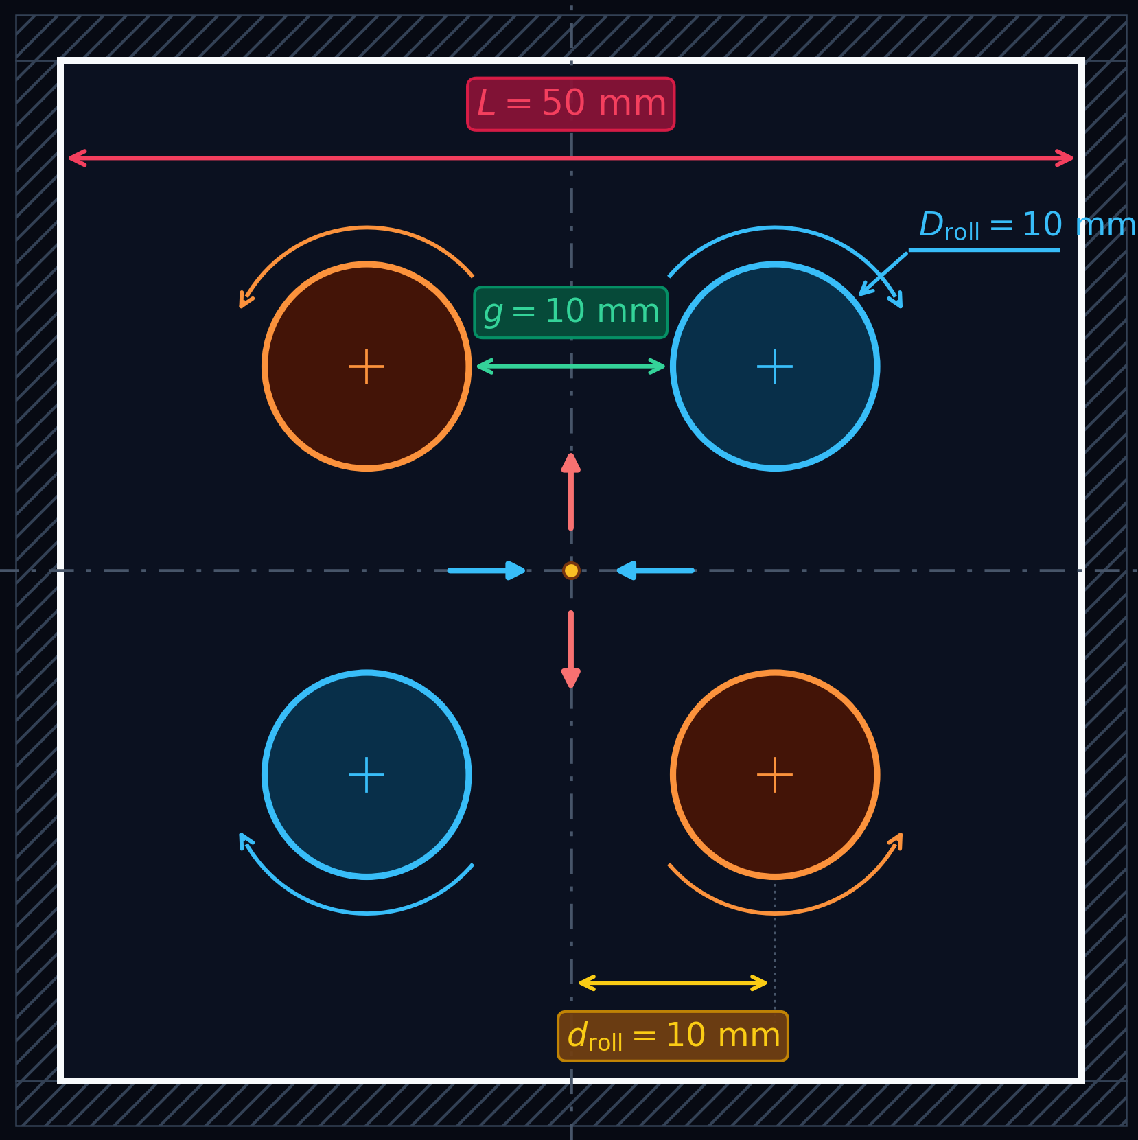
CFD Modeling: Geometric Ratios & Benchmark Setup
GEOMETRIC DOMAIN
Characteristic Dimensions
GEOMETRIC RATIOS
CYLINDER RATIO (Droll / L)
0.2
POSITIONING RATIOS (droll / L)
0.2
Reference: D’Avino et al. (2017) – Numerical simulations of dispersive mixing of viscoelastic suspensions in a four-roll mill
Notes:
aumentare dimensioni numeri

Slide 28
Physical Assumptions
01
FLUID DENSITY
Incompressible
Constant density ⟶ ∇·u = 0.
Automatically satisfied through the formulation of the stream function (ψ).
02
FORCE FIELDS
No Gravity
Negligible gravity forces ⟶ g = 0.
Isolates purely hydrodynamic forces and eliminates mass/body force terms in momentum balance.
03
THERMODYNAMICS
Isothermal
Uniform temperature profile ⟶ T = const (∇T = 0).
Decouples the energy equation and eliminates thermal dissipation effects.

Slide 29







Recap: Governing Equations & Boundary Conditions
01 CONTINUITY EQUATION
Incompressible Flow Regime
02 MOMENTUM BALANCE
Quasi-Stokes Steady-State
03 RHEOLOGICAL CONSTITUTIVE EQUATION
Giesekus Model Formulation
04 BOUNDARY CONDITIONS
Wall, Roll No-Slip & Pressure Reference
• Outer Walls (No-Slip):
• Rotating Rolls(No-Slip):
• Pressure Point:

Slide 30

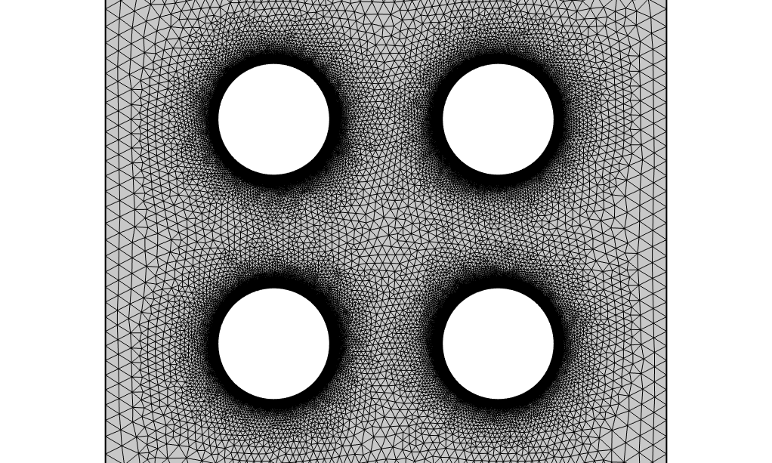
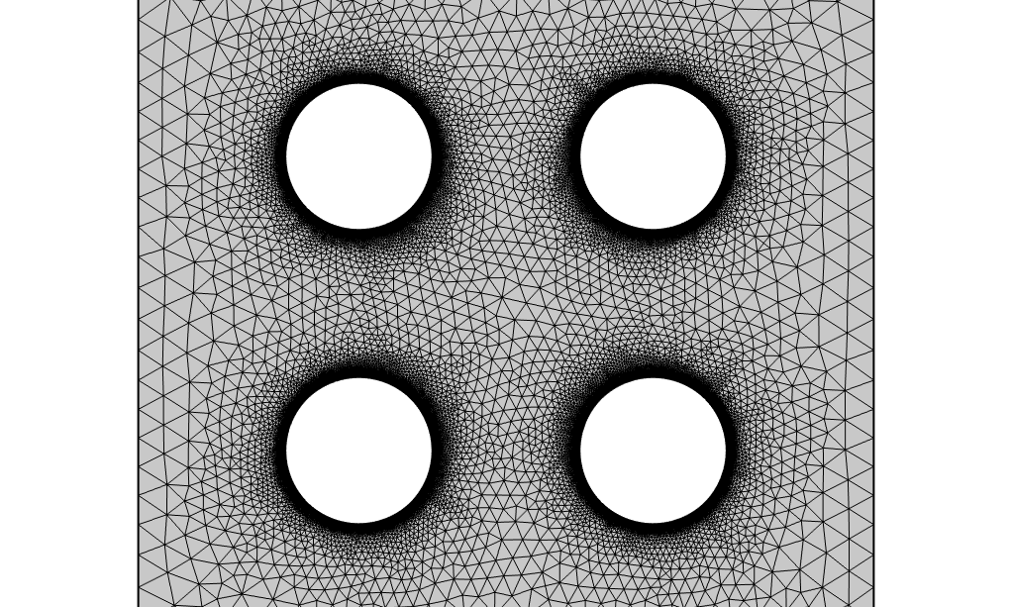
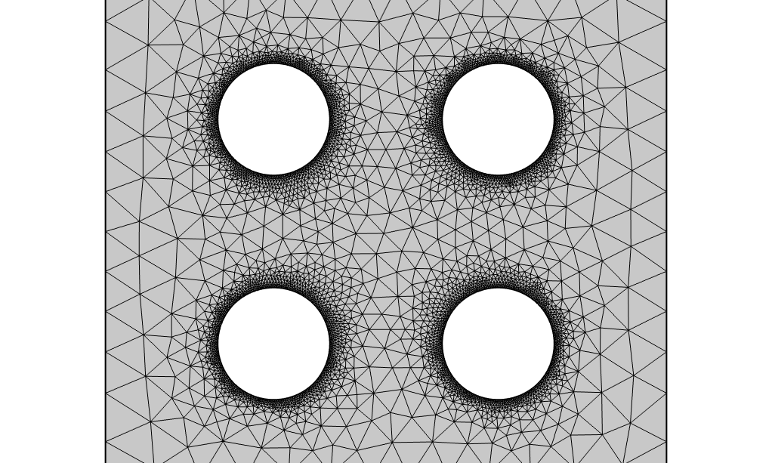
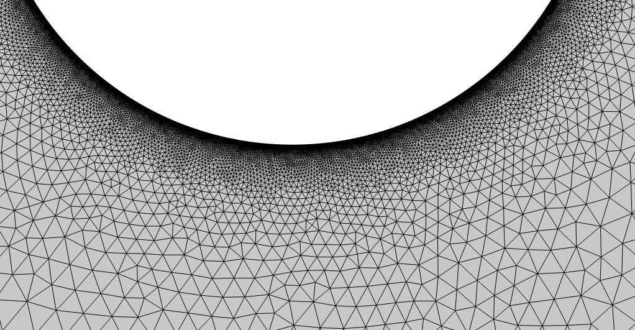
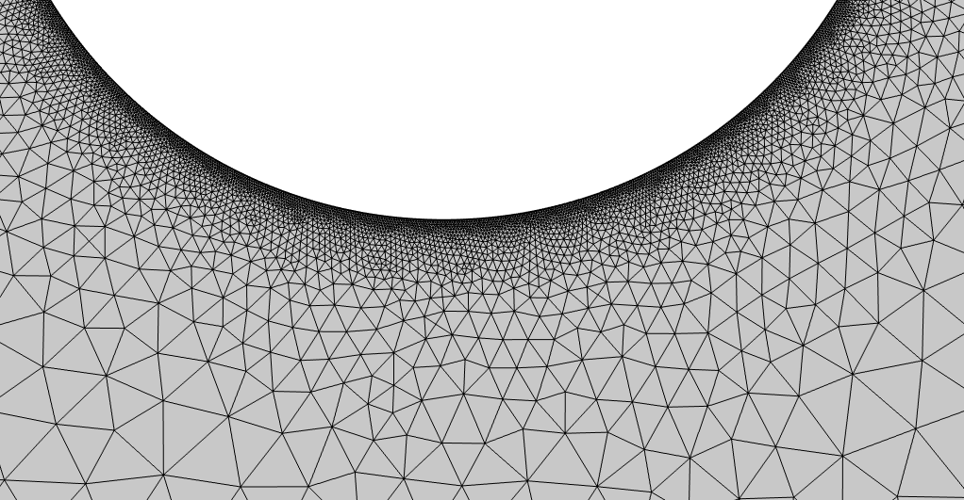
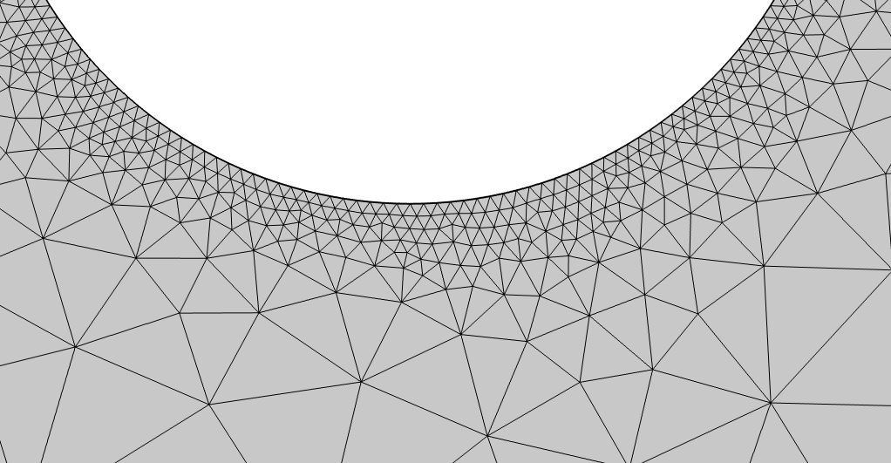
CFD Meshes & Boundary Detail
125k
52k
5k
▼ DETAIL
▼ DETAIL
▼ DETAIL
High boundary layer refinement
Balanced mesh density
Coarse discretization

Slide 31
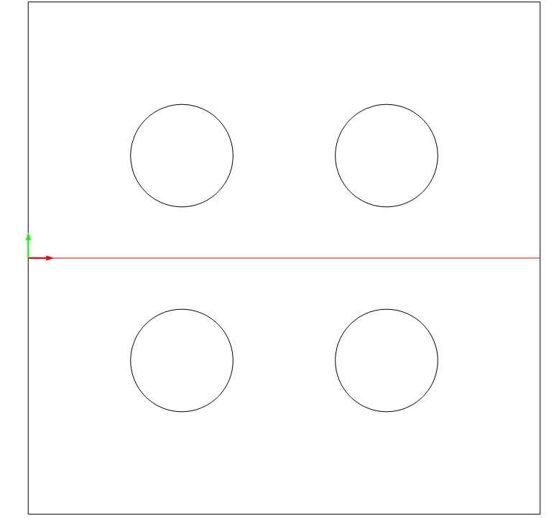
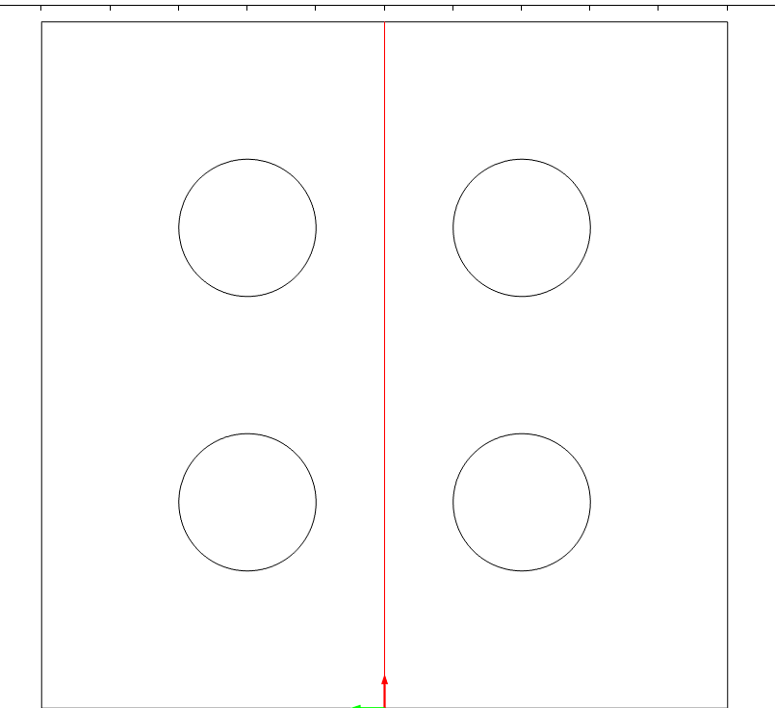
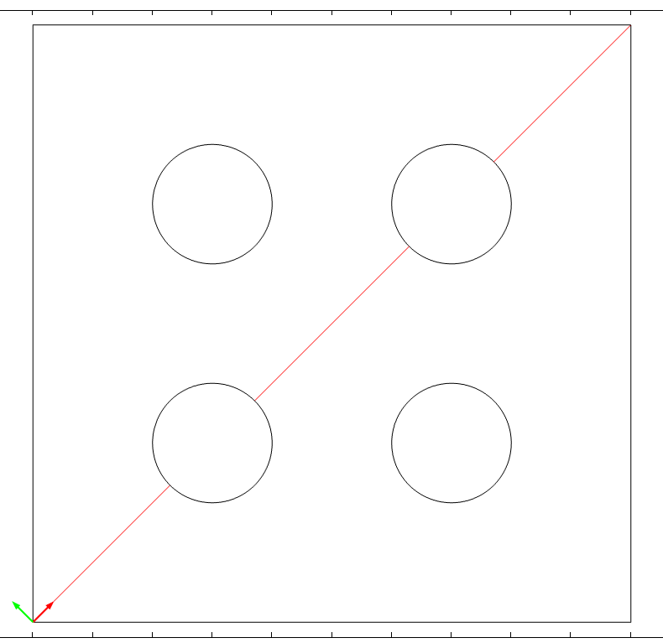
Relevant Cutlines
HORIZONTAL CUTLINE
VERTICAL CUTLINE
OBLIQUE CUTLINE
Horizontal cross-section passing through the domain center
Vertical cross-section along the central symmetry axis
Diagonal cross-section traversing opposite domain corners

Slide 32
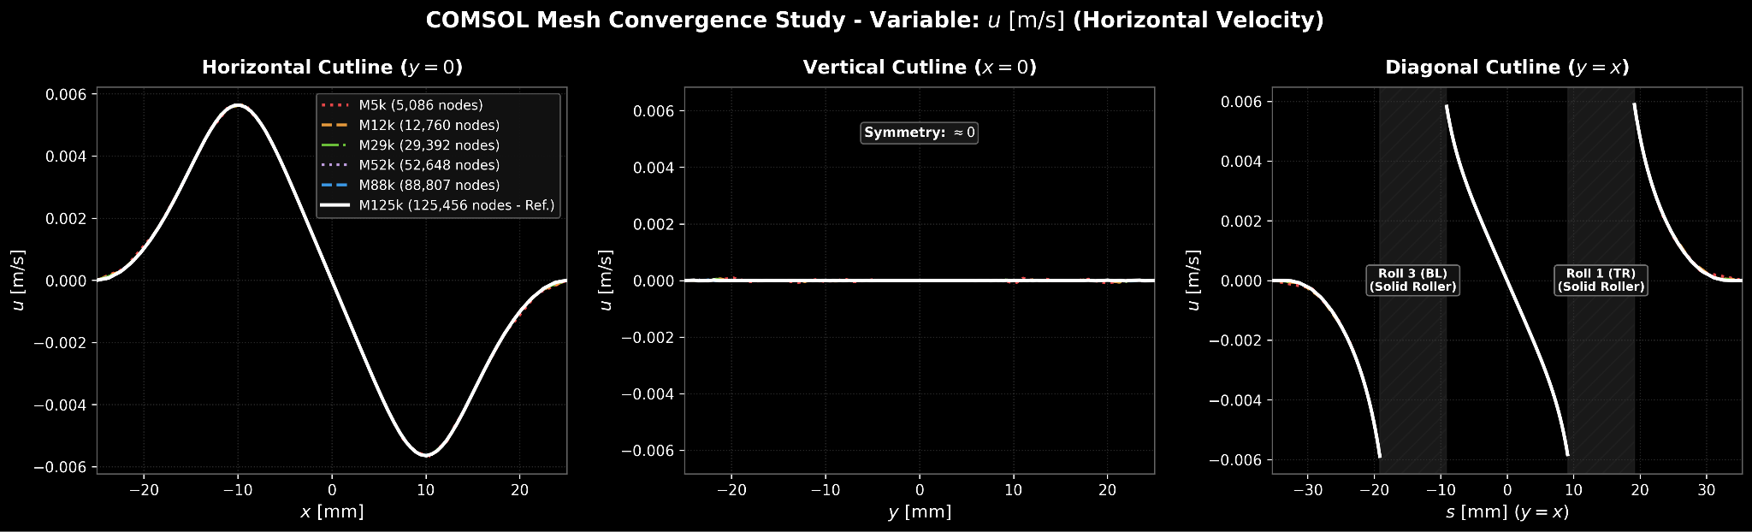
Horizontal Velocity (u)
SETUP: Mesh Convergence
MESH: All
PARAMS: λ =1 s, ηp​ = 0.9 Pa s
Notes:
Valore di errore sulla convergenza di tutti i parametri su tutto il dominio tabella magari
provare differenza tra mesh sui vari campi

Slide 33
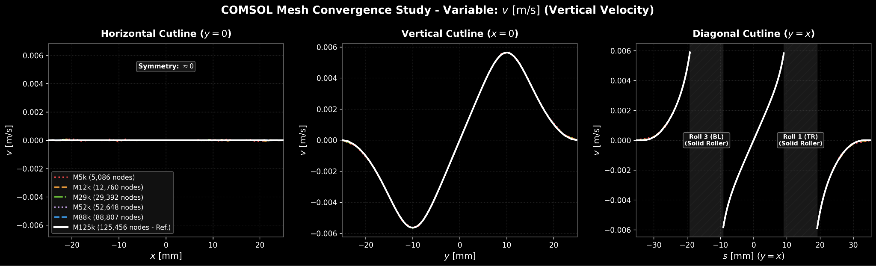
v

Slide 34
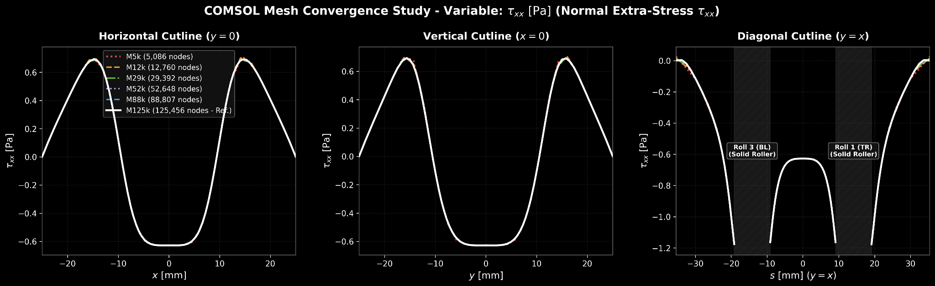
Normal extra stress (tauxx)
SETUP: Mesh Convergence
MESH: All
PARAMS: λ =1 s, ηp​ = 0.9 Pa s

Slide 35
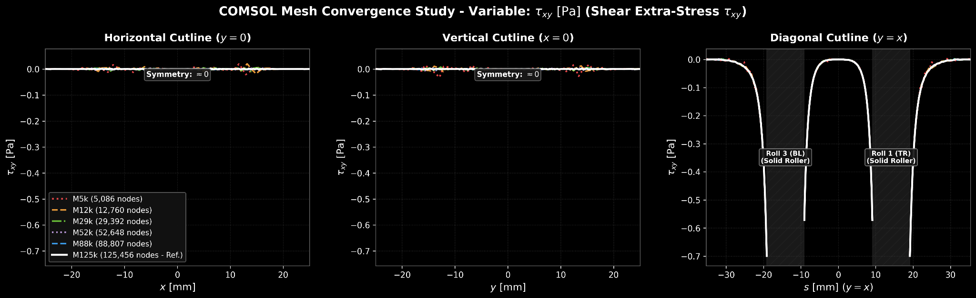
Shear stress (tauxy)
SETUP: Mesh Convergence
MESH: All
PARAMS: λ =1 s, ηp​ = 0.9 Pa s

Slide 36
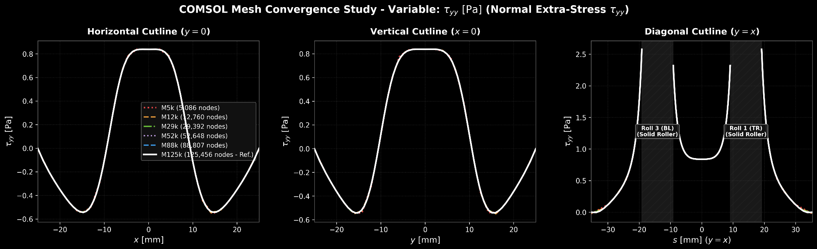
tauyy

Slide 37
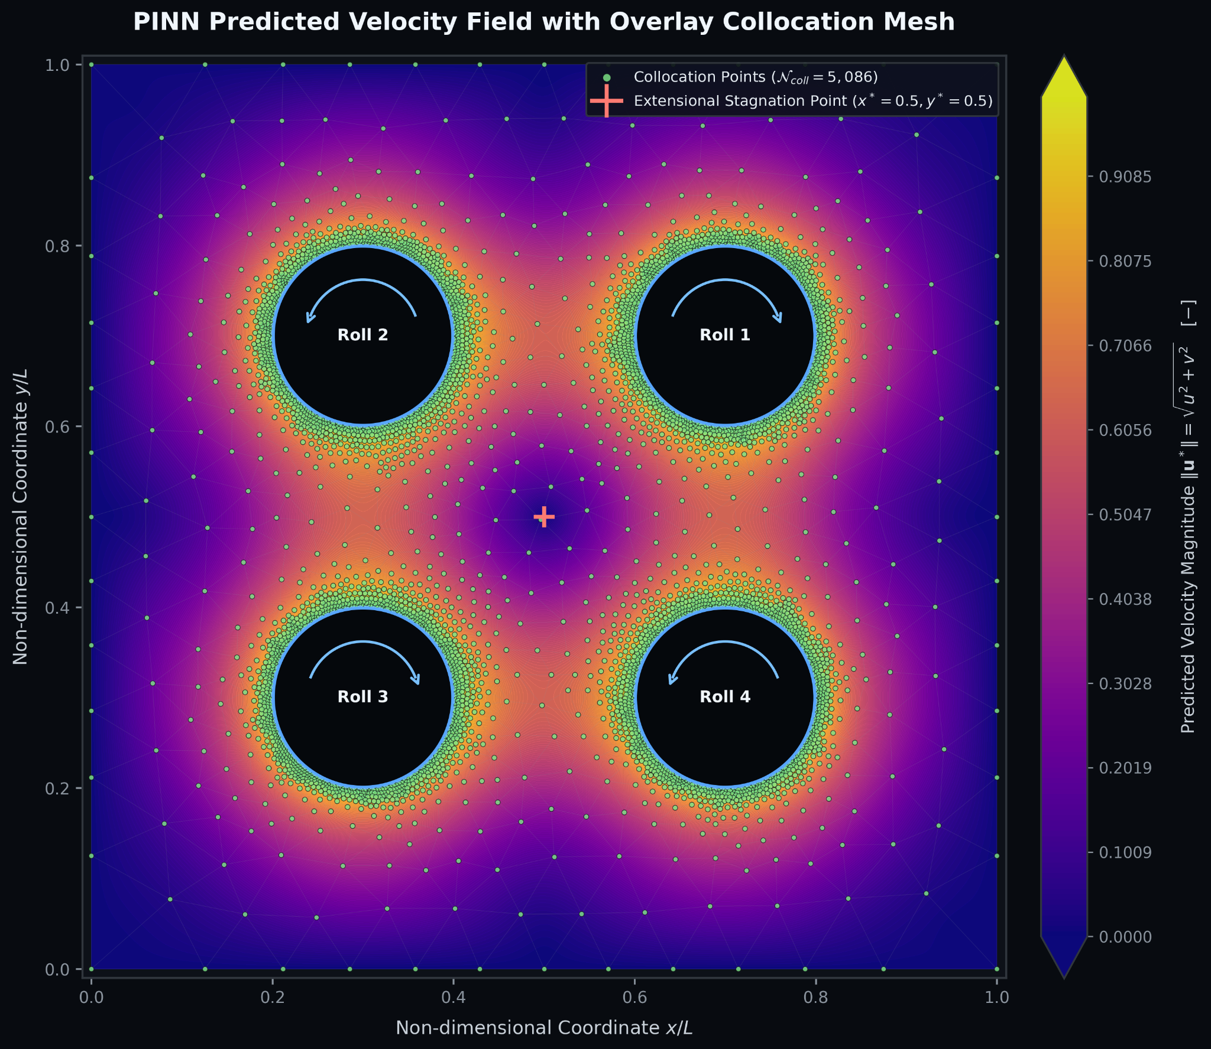
Physical parameters & Collocation Points
Physical Parameters
Roll Velocity (uroll): 8.333 × 10⁻³ m/s
Density (ρ): 1000 kg/m³
Flow Characteristics:
Purely extensional flow field considering flow parameter
Reynolds Num. (Re): 0.0417 ≪ 1
Weissenberg Num. (Wi):
Deborah Num. (De):

Slide 38



Multi-Objective Loss Function & BC Formulation
Ltotal = wdata · Ldata + wbc · Lbc + wconst · Lconst + wmom · Lmom
1. Velocity Data Loss (Ldata)
2. Constitutive Eq. (Lconst)
3. Momentum Balance (Lmom)
4. Boundary Conditions (Lbc)
• No-Slip Kinematics
• Stress Tensor Anchor
• Pressure Point Reference
5. Staged Training Strategy
• Phase 1 (Rheology & Kinematics): wmom = 0, wconst > 0 → Trains stream function ψ, stress τ, and learns inverse parameters (λ, μp, α, ε).
• Phase 2 (Hydrodynamics & Pressure): wconst =0, wmom > 0, τ frozen → Solves pressure field p and solvent viscosity μs with ψ fine-tuned at reduced learning rate.
Notes:
Dare nome dei boundary e sul boundary dire cosa è imposto sotto forma di equazioni e a voce dico cosa rappresentano
appis staged training

Slide 39
PINN Training Setup & Parameters [Direct / Forward Problem]
1. Network Architecture
2. Staged Optimization Strategy
Structure: 3 Decoupled Heads
Inputs/Outputs:
(x,y) → ψ (1), p (1), τ (3: τxx, τxy, τyy)
Layers: 8 hidden layers × 128 neurons
Activation: SiLU (smooth 2nd derivatives)
Weights: Xavier Normal (Zero-init p & τ last layer)
PHASE 1: Kinematics & Rheology
• Train ψ & τ; Freeze p (Wmom=0, Wcon=1.0)
• Fixed Parameters: λ, μp, α, ε (No inverse learning)
PHASE 2: Hydrodynamics & Pressure
• Freeze τ (precomputed ∇·τ); Train p & ψ
• Micro-unfreezing: ψ active at LR/10
• Known solvent viscosity μs (Wmom=1.0, Wcon=0)
4. Multi-Stage Precision & Solvers
5. Loss Weights & Infrastructure
Stage 1: Adam
Epochs: 40k (Scratch) / 20k (TL)
Base LR: 2.5 × 10-3
Scheduler: Cosine Annealing
(down to ηmin = 2.5 × 10-6)
Precision: FP32
Stage 2: L-BFGS
Max Iter: 10k (Scratch) / 5k (TL)
Line Search: strong_wolfe
Precision: Full FP64 / Double conversion
Loss Weights Configuration:
Phase 1: Wdata=1.0 | Wbc=5.0 | Wcon=1.0 | Wmom=0.0 | Wroll_stress=1.0
Phase 2: Wdata=20.0 | Wbc=5.0 | Wmom=1.0 | Wcon=0.0
Reproducibility: Fixed Global Seed = 123

Slide 40

PINN Strategy: Direct vs. Inverse Problem Comparison
1. Network Architecture (Shared Baseline)
Structure: 3 Decoupled Heads | Layers: 8 hidden layers × 128 neurons | Activation: SiLU
Inputs / Outputs: (x,y) → ψ (1), p (1), τ (3: τxx, τxy, τyy) | Epochs: Adam 40k (20kTL)+ L-BFGS 10k (5kTL)
Base LR: 2.5 × 10-3 | Scheduler: Cosine Annealing (down to ηmin = 2.5 × 10-6)
Direct Problem (Forward)
Inverse Problem (Parameter Learning)
PHASE 1: Kinematics & Rheology
• Train ψ & τ; Freeze p (Wmom=0, Wcon=1.0)
• Fixed Parameters: λ, μp, α, ε (No inverse learning)
PHASE 1: Kinematics & Rheology
• Train ψ & τ; Freeze p (Wmom=0, Wcon=1.0)
• Active Parameters: λ, μp, α, ε (Inferred online)
PHASE 2: Hydrodynamics & Pressure
• Freeze τ (precomputed ∇·τ); Train p & ψ
• Micro-unfreezing: ψ active at LR/10
• Known solvent viscosity μs (Wmom=1.0, Wcon=0)
NO PHASE 2

Slide 41
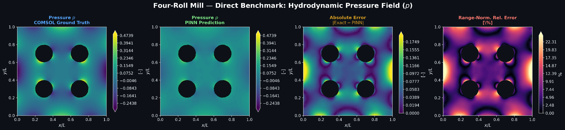
Four-Roll Mill — Hydrodynamic Pressure (p)
SETUP: Direct Problem
MESH: M5k
PARAMS: λ =0.05 s, ηp​ = 0.9 Pa s
Notes:
appendere errore assoluto solo relativo e zoommato

Slide 42
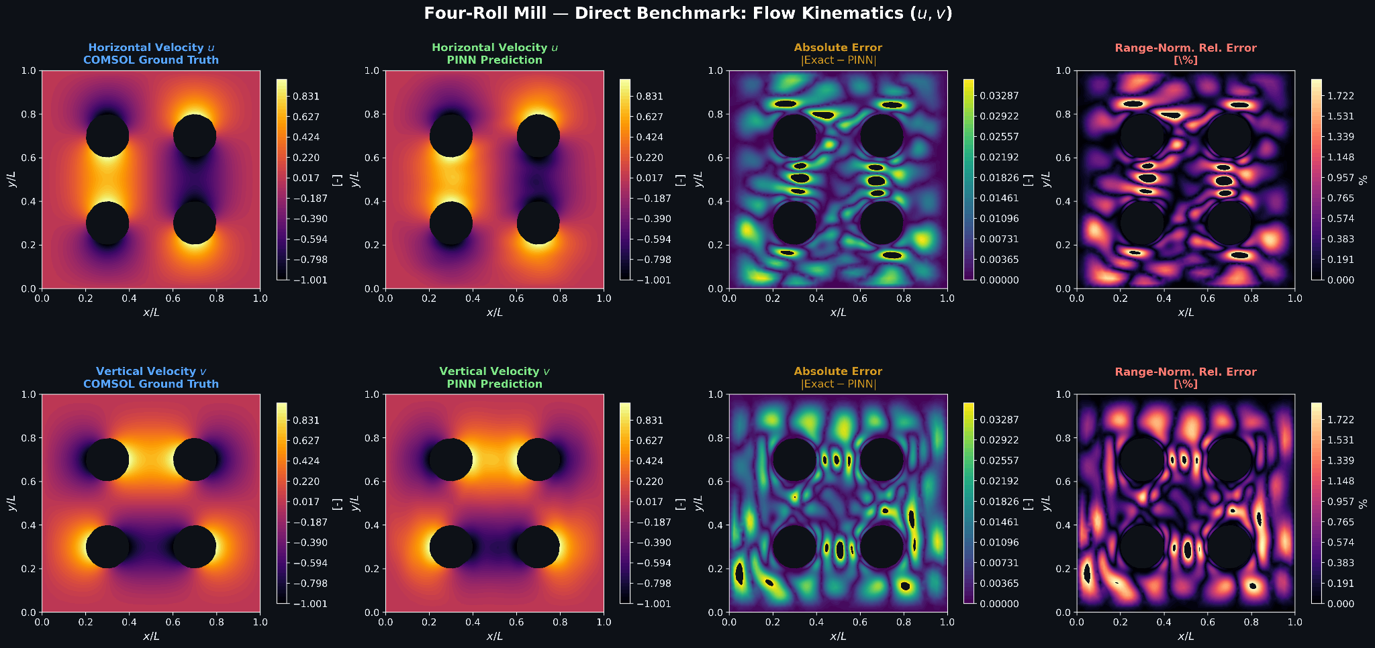
Four-Roll Mill — Flow Kinematics (u,v)

Slide 43
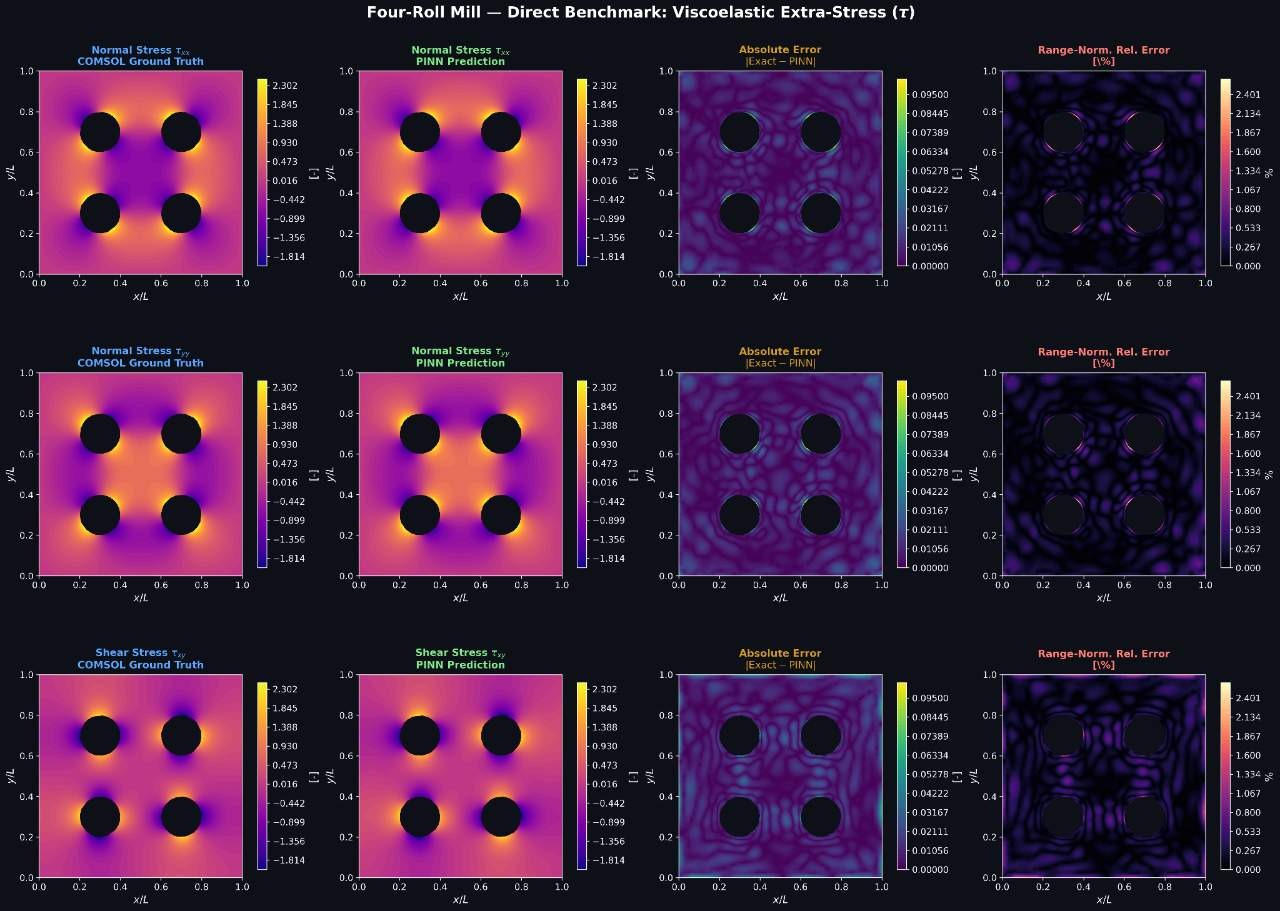
Four-Roll Mill — Viscoelastic Extra-Stress (τ)

Slide 44
PINN Training Setup & Parameters [Inverse Problem]
1. Network Architecture
2. Staged Optimization Strategy
Structure: 3 Decoupled Heads
Inputs/Outputs:
(x,y) → ψ (1), p (1), τ (3: τxx, τxy, τyy)
Layers: 8 hidden layers × 128 neurons
Activation: SiLU (smooth 2nd derivatives)
Weights: Xavier Normal (Zero-init p & τ last layer)
PHASE 1: Kinematics & Rheology
• Train ψ & τ; Freeze p (Wmom=0, Wcon=1.0)
• Active Parameters: λ, μp, α, ε
NO PHASE 2
PHASE 2: Hydrodynamics & Pressure
• Freeze τ (precomputed ∇·τ); Train p & ψ
• Micro-unfreezing: ψ active at LR/10
• Known solvent viscosity μs (Wmom=1.0, Wcon=0)
4. Multi-Stage Precision & Solvers
5. Loss Weights & Infrastructure
Stage 1: Adam
Epochs: 40k (Scratch) / 20k (TL)
Base LR: 2.5 × 10-3
Scheduler: Cosine Annealing
(down to ηmin = 2.5 × 10-6)
Precision: FP32
Stage 2: L-BFGS
Max Iter: 10k (Scratch) / 5k (TL)
Line Search: strong_wolfe
Precision: Full FP64 / Double conversion
Loss Weights Configuration:
Phase 1: Wdata=1.0 | Wbc=5.0 | Wcon=1.0 | Wmom=0.0 | Wroll_stress=1.0
Phase 2: Wdata=20.0 | Wbc=5.0 | Wmom=1.0 | Wcon=0.0
Reproducibility: Fixed Global Seed = 123

Slide 45
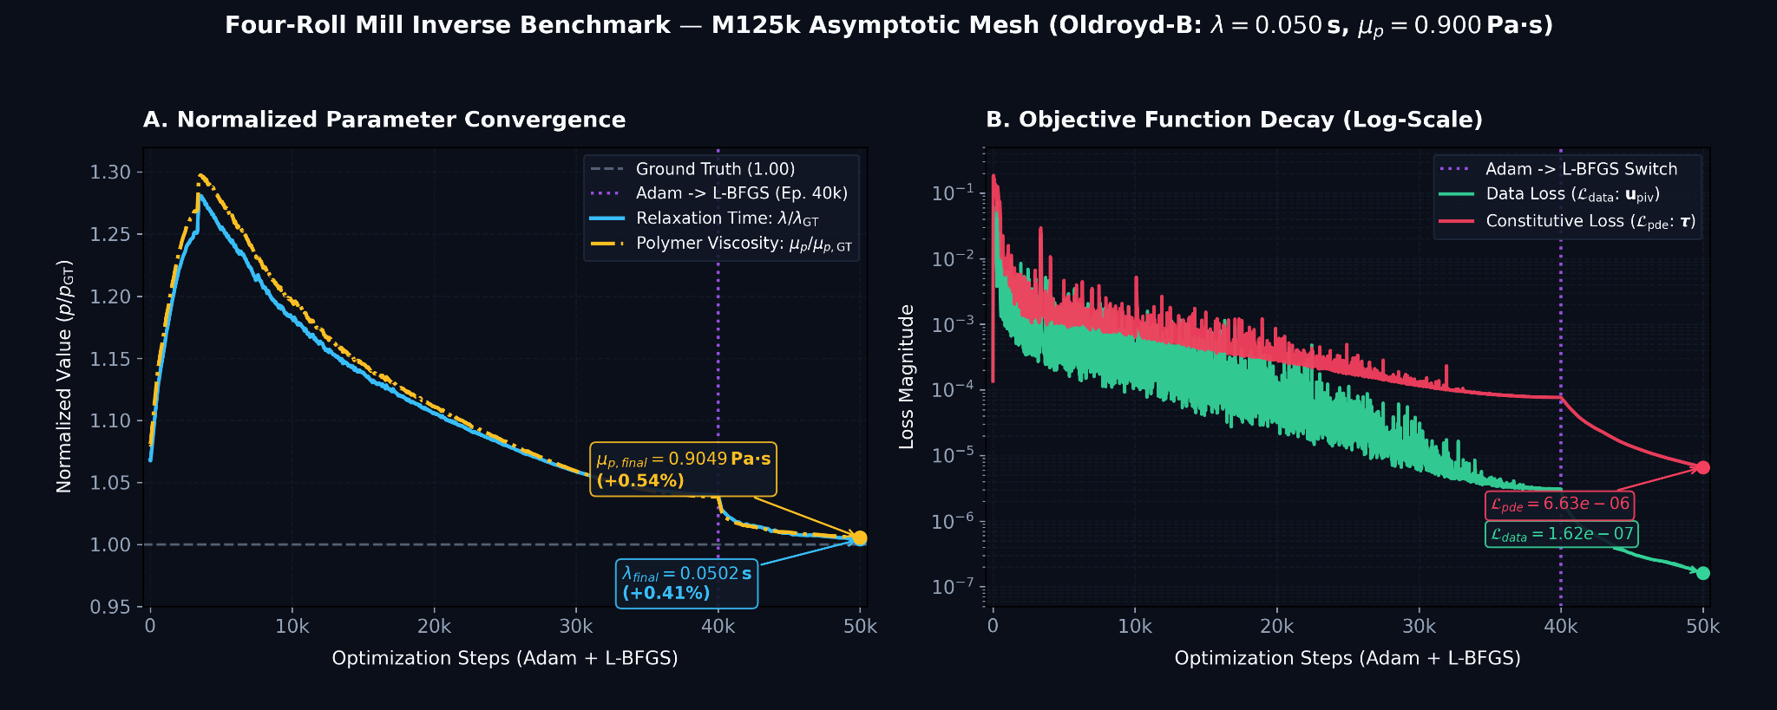
Four-Roll Mill — Inverse Problem Results
SETUP: Inverse Parameter Estimation
MESH: M125k (Highest Resolution)
PARAMS: λ =0.05 s, ηp​ = 0.9 Pa s

Slide 46

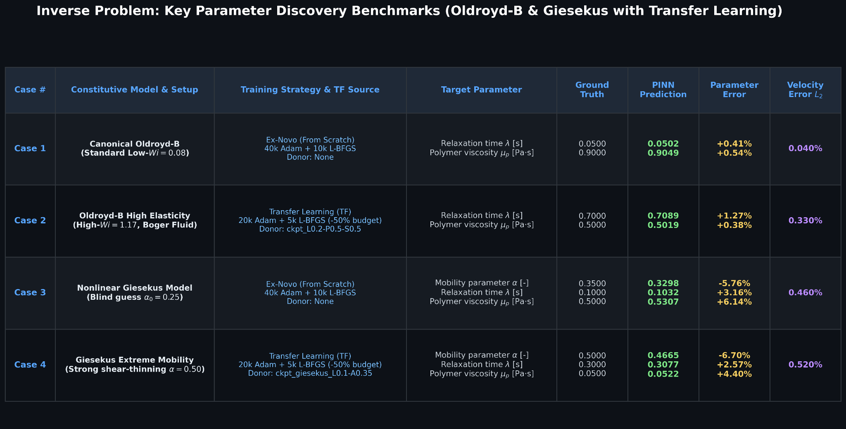
Inverse Problem: Key Parameter Discovery Benchmarks

Slide 47
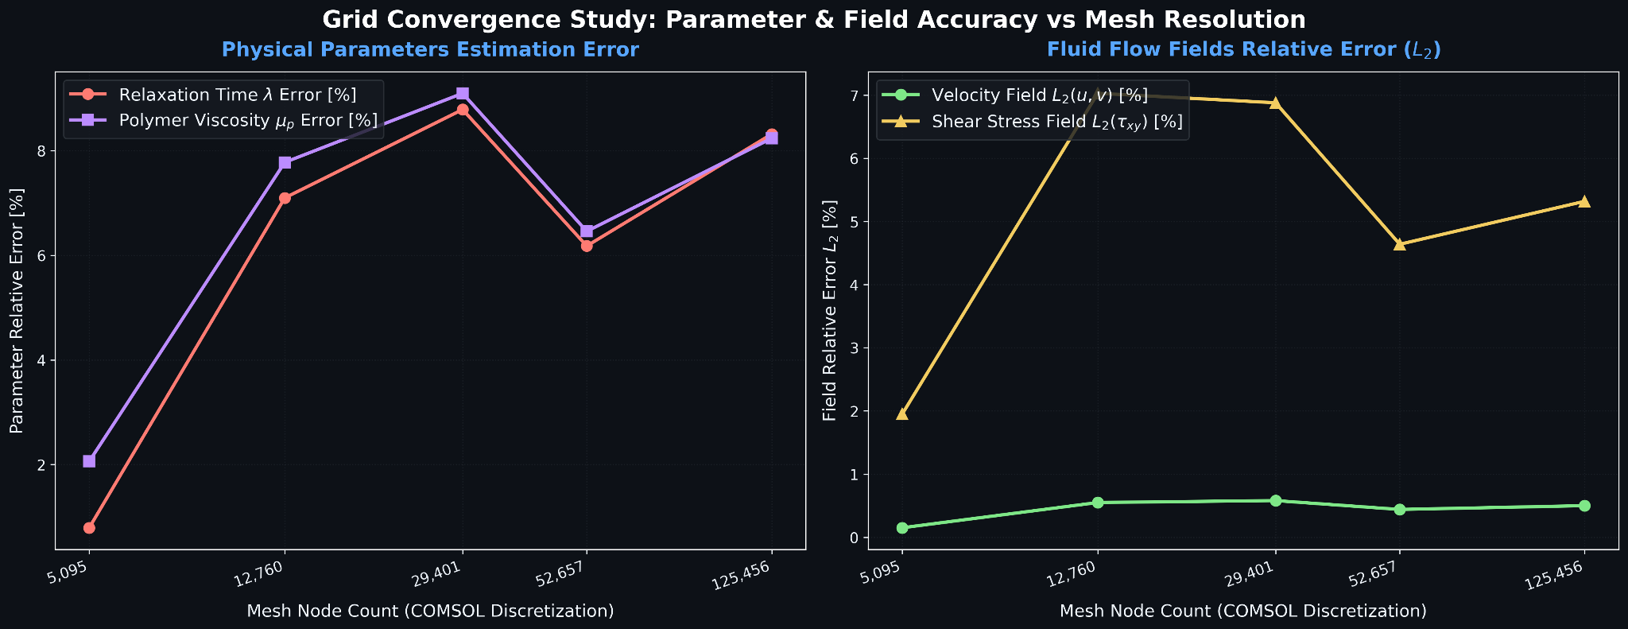
Grid Convergence Study — Accuracy vs. Mesh Resolution
SETUP: Mesh Robustness
MESH: All
PARAMS: λ =0.1 s, ηp​ = 0.5 Pa s

Slide 48
Validation and Advantages of Transfer Learning
01. MOTIVATION
Why Transfer Learning?
Training a viscoelastic PINN from scratch for each new set of physical parameters or operating conditions is:
Computationally expensive in terms of time and resources.
Subject to convergence towards unfavorable local minima.
02. STRATEGY
Implemented Workflow
1. Pre-training
Training on a base case (low λ)
2. Fine-Tuning
Weight transfer towards severe conditions (higher viscoelasticity or kinematic variations).
03. RESULTS
Advantages and Impact
Convergence Acceleration
Numerical Stability
High-Efficiency Scalability

Slide 49
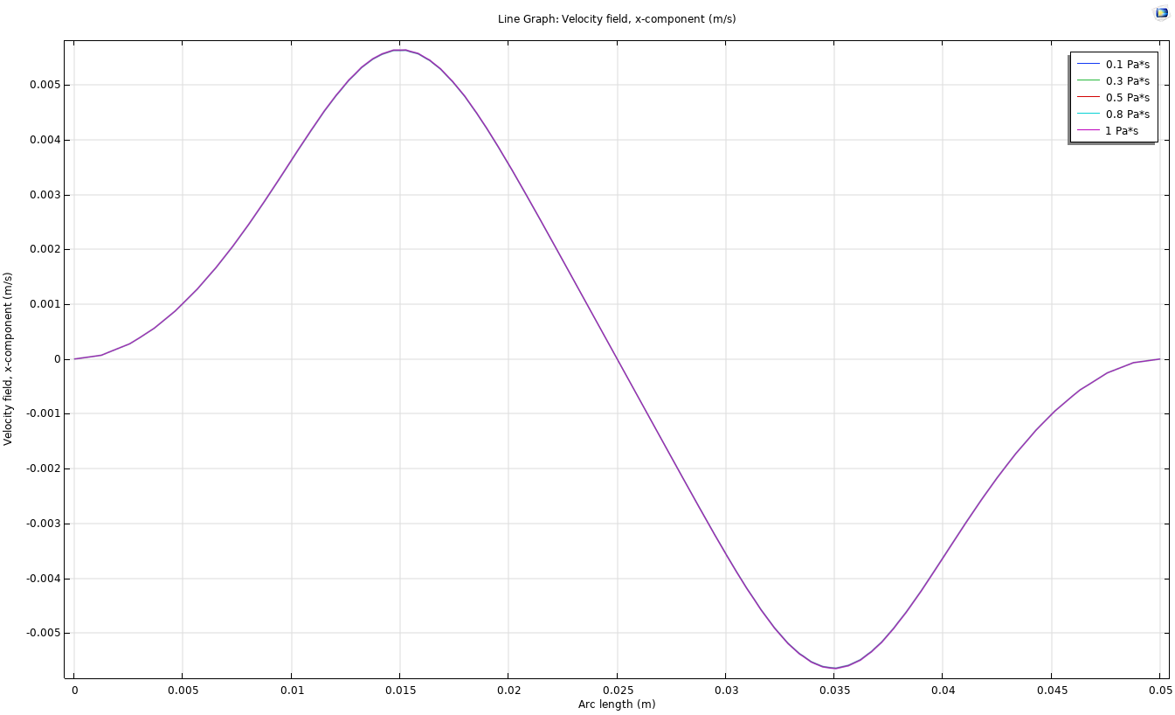
Phase 2 Inverse Problem Limits
01. IDENTIFIABILITY ISSUE
Identifiability Study on ηs
Our current setup renders velocity fields insensitive to variations in solvent viscosity (ηs):
Velocity Field Invariance
Changes in ηs produce indistinguishable effects on the velocity profiles.
Optimization Bottleneck
Loss functions struggle to compute gradients for parameter recovery.
02. CONVERGENCE ANALYSIS
Convergence Plot (ηs)

Slide 50
PTT Inverse Problem Benchmark Results
Benchmark / Dataset
εtrue → εest
(ε Error)
λtrue → λest [s]
(λ Error)
μp,true → μp,est [Pa·s]
(μp Error)
L2(u,v)
Kinematics Error
PTT (λ=1.0, ε=0.3)
L1-P0.5-S0.5-A0-E0.3
0.300 → 1.7×10−4
-99.94%
1.000 → 0.4211
-57.89%
0.500 → 0.2128
-57.44%
0.79%
PTT (λ=0.7, ε=0.5)
L0.7-P0.95-S0.05-A0-E0.5
0.500 → 4.4×10−4
-99.91%
0.700 → 0.2700
-61.43%
0.950 → 0.3687
-61.19%
0.88%
Key Observation:
While individual parameters λ, μp, and ε show high estimation errors (systematic underestimation), the L2 kinematic error remains extremely low (< 0.9%), pointing directly to a parameter identifiability issue.

Slide 51





Proposals to Overcome Setup Limitations
01. SOLVENT VISCOSITY (ηs)
Higher Reynolds Number Regime
Explore a solution space where inertia becomes more relevant (higher ).
Objective:
Amplify the physical impact of solvent viscosity on velocity profiles to break sensitivity invariance.
Expected Outcome:
Sharpen loss function gradients for accurate recovery of .
02. VISCOELASTIC MODEL (PTT)
Exponential PTT Formulation
Transition to an exponential Phan-Thien-Tanner (PTT) model formulation.
Objective:
Overcome mathematical & physical limits tied strictly to the stationary regime setup.
Expected Outcome:
Resolve parameter coupling between , , and for unique parameter identifiability.

Slide 52
Research Directions & Next Steps
Future Development
01. KINEMATICS MODIFICATION
Flow Field Alteration
Focus on changing the flow field configurations to study non-standard velocity dynamics.
02. STOCHASTIC PERTURBATION
Gaussian Noise Addition
Incorporate Gaussian noise into the synthetic datasets and flow fields to evaluate numerical robustness, regularization stability, and solver resilience under uncertainty.
03. CONSTITUTIVE FORMULATION
Exponential PTT Integration
Transition to exponential PTT (ePTT) instead of linear PTT in ViscoelasticNet.
04. NUMERICAL BOUNDS
Convergence Range Exploration
Conduct thorough parameter sweeps to map out and expand the convergence envelope across varying Weissenberg numbers, Reynolds regimes, and loss weighting setups.

Slide 53
Literature Review • 2026
Latest Literature Development
RECENT PUBLICATION (2026)
Simulation of Steady Viscoelastic Creeping Flows with Physics-Informed Neural Networks
José X. Matosa, C. Fernandesa, M. A. Alvesa,*
a CEFT, ALiCE, Faculty of Engineering, University of Porto, Rua Dr. Roberto Frias, s/n 4200-465 Porto, Portugal.

Slide 54
Thank You for Your Attention

Slide 55
Governing Equations & Viscoelastic Formulation
Coupling mass conservation, Cauchy momentum balance, and constitutive stress tensor relations
SYSTEM OF GOVERNING PARTIAL DIFFERENTIAL EQUATIONS
Mass Conservation
∇ · u = 0
Incompressible flow condition
Cauchy Momentum Balance
ρ(u · ∇)u = -∇p + ∇ · τ
Steady-state momentum transport
Constitutive Relation
τ = τs + τp
Solvent & polymer stress split
DIMENSIONLESS PARAMETERS & REGIMES
PHYSICAL DOMAIN & RHEOLOGICAL MODEL
Re — Reynolds Number
Characterizes the ratio of inertial forces to viscous forces within the fluid domain, governing flow stability.
Wi — Weissenberg Number
Quantifies fluid elasticity and polymer relaxation time relative to the characteristic rate of flow deformation.
Flow Specification: The physical domain models steady-state, incompressible viscoelastic flow under isothermal conditions.
Stress Response: Defined by a viscoelastic constitutive model partitioning the total stress tensor into Newtonian solvent and elastic polymer contributions.
System Coupling: Momentum balance and non-linear constitutive equations dictate the final flow behavior across the domain.

Slide 56
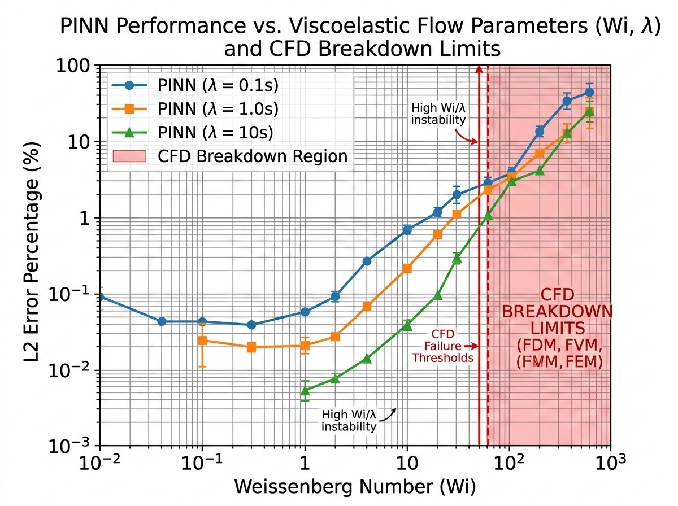
High-Elasticity Flow Modeling
High Weissenberg Number Problem Mitigation
Regime Stability & Computational Overhead
Bypassing Numerical Breakdown
The physics-informed framework demonstrates robust performance in complex regimes, effectively bypassing the High Weissenberg Number Problem.
By eliminating complex meshing requirements for viscoelastic flow domains, the model maintains numerical stability and accuracy even in highly non-linear regimes.
High-Fidelity Prediction Capability
Non-Linear Stress & Velocity Kinematics
The mesh-free solver achieves high-fidelity predictions of both velocity kinematics and non-linear stress tensors.
It mitigates the numerical breakdown and steep computational overheads traditionally associated with high elasticity and complex relaxation time behaviors.
Quantitative Benchmark: L2 Error vs. Weissenberg Number (Wi)
Comparative breakdown highlighting CFD failure thresholds against mesh-free PINN stability.

Slide 57
Non so se aggiungere anche questo forse alla fine
COMPUTATIONAL ENGINEERING IMPLICATIONS
Take-Home Messages & Method Positioning
Core Strengths
Ideal for solving inverse problems and parameter identification.
Seamless sparse experimental data assimilation (e.g., PIV velocity fields).
Quantifies unmeasurable latent physical variables directly.
Practical CFD Positioning
Does not aim to replace mature forward CFD solvers (FVM / FEM) for high-fidelity forward predictions.
Acts as an integrative framework, bridging real experimental data with physical models.
Experimental Data (PIV) + Physical Laws ➔ PINN Integration

